Slide 1



Stroke Data
Analysis
By
Neelanjan Chakraborty

Slide 2
Contents
Business Objective – Problem Statement
Solution Methodology
Data Preparation and Consolidation
Key Challenges
Result
Conclusion

Slide 3

Business Objective
– Problem Statement
Stroke is a critical health problem globally as It remains as the second leading cause of death worldwide since 2000.
Apart from that, stroke is the third major cause of disability.
Long term disability affects people severely, in terms of their productive life.
As such, stroke possesses significant threat to global health.
Problem Statements
This analysis aims to identify the risk factors for stroke.
Results were visualized and discovered.
Objectives

Slide 4
Solution Methodology
Solution Methodology
Technology Enablers
Realized Objectives
The patient data was obtained
Spreadsheet
&
Power BI
This analysis aims to identify the risk factors for stroke.
Results were visualized and discovered.
Prepared & Processed Data
Analyze
Act

Slide 5
Data Preparation and Consolidation
How many male and female suffer from heart disease?
How many people male and female suffer from hypertension?
How many people are diseased and healthy patients?
How many people got first heart stroke in age range of 10 years gap?
How many people suffer from heart disease with smoking habit?
How many people living in urban area and rural area have heart disease?
How many people suffer from hypertension with working status?
How many people suffer from hypertension with marital status?
How many people suffer from heart disease with working status?
How many people suffer from heart disease with marital status?

Slide 6



1. How many male and female suffer from heart disease?
113 (40.94%)
Gender
Male
Female Other
163 (59.06%)

Slide 7
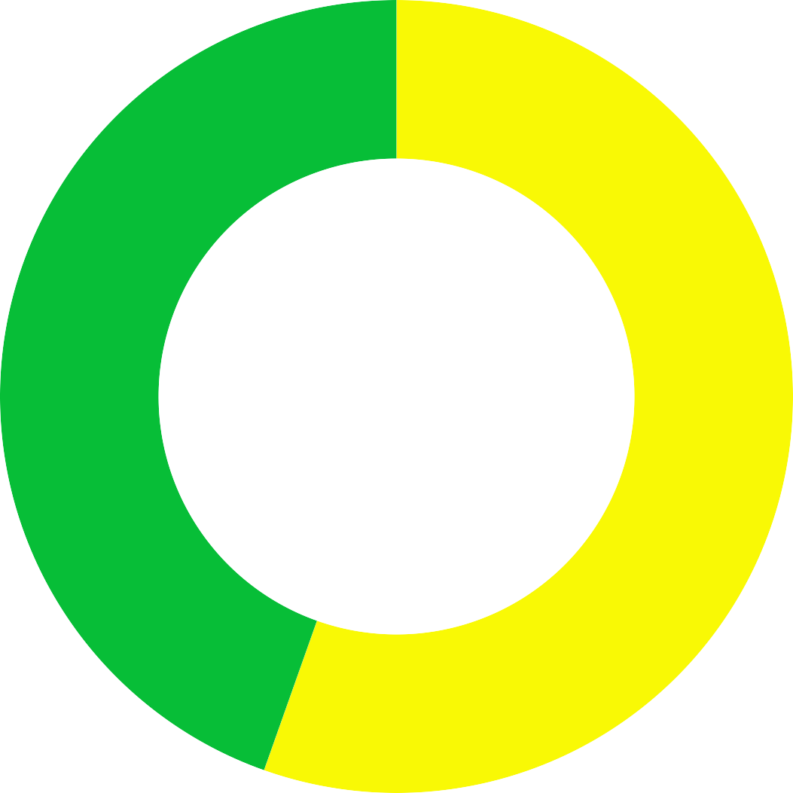



2. How many people male and female suffer from hypertension?
222 (44.58%)
Gender
Female Male
Other
276 (55.42%)

Slide 8


3. How many people are diseased and healthy patients?
276 (5.4%)
Heart Disease
0
1
4834 (94.6%)

Slide 9


4. How many people got first heart stroke in age range of 10 years gap?
800
600
Stroke
0
1
Count of id
400
200
0
0
20
40
age (bins)
60
80

Slide 10




5. How many people suffer from heart disease with smoking habit?
40
30
Smoking Status
formerly smoked
never smoked smokes Unknown
Heart Disease
20
10
0
0
20
40
age (bins)
60
80

Slide 11

6. How many people living in urban area and rural area have heart disease?
50
40
Smoking Status
Rural
Heart Disease
30
Urban
20
10
0
0
20
40
age (bins)
60
80

Slide 12






7. How many people suffer from hypertension with working status?
140
120
100
Working Status
children
Govt_job Never_worked Private
Self-employed
Hypertension
80
60
40
20
0
0
20
40
age (bins)
60
80

Slide 13


8. How many people suffer from hypertension with marital status?
80
60
Marital Status
No
Yes
age (bins)
40
20
0
0
20
40
60
80
100
120
140
Hypertension

Slide 14
7. How many people suffer from hypertension with working status?
100
80
Working Status
children
Govt_job Never_worked Private
Self-employed
Heart Disease
60
40
20
0
0
20
40
age (bins)
60
80

Slide 15
8. How many people suffer from hypertension with marital status?
80
60
Marital Status
No
Yes
age (bins)
40
20
0
0
20
40
60
Heart Disease
80
100

Slide 16

Key Challenges
Data preprocessing is a very important step.
Do not jump straight to analysis or prediction while the data is dirty.
Do not automatically drop all records which contain missing values.
They may contain valuable information.
Consider other alternatives,
i.e. replace them with mean or median value if it is a numerical attribute,
or create a new category if it is a categorical attribute.
Not all insights are breakthrough.
Probe further.
They may be highly associated with another variable after all.

Slide 17
Power BI dashboard allows to
Discover what’s important
Tell stories and share them with team members
Make data-driven business decisions
Project Plan and Support Required
Results
Conclusion
There a total of 10 insights found in the stroke dataset:
It seemed like both BMI and Age were positively correlated, though the association was not strong.
Older patient was more likely to suffer a stroke than a younger patient.
Higher BMI does not increase the stroke risk.
Diabetes is one of the risk factors for stroke occurrence and prediabetes patients have an increased risk of stroke.
Higher proportion of patients who suffered from hypertension or heart disease experienced a stroke, all else being equal.
Regardless of patient’s gender, and where they stayed, they have the same likelihood to experience stroke
Work type variable was highly associated with age.
Marital status variable was highly associated with age.

Slide 18
THANK YOU

